Slide 1

INNOVATEWITHAJAY
Brand guidelines
A practical identity for people who learn, build and innovate.
Clean laptop. Compact iA. One AI sparkle.
Production edition 2.0 / 29 October 2026
INNOVATEWITHAJAY / CLEAN LAPTOP EDITION / v2.0
01

Slide 2
01 / BRAND IDEA
Practical, clear, forward-looking.
InnovateWithAjay connects technology learning, mentorship and implementation. This kit keeps that promise visually simple.
01
02
03
Learn
Build
Innovate
Make complex ideas understandable. Prefer useful examples over vague claims.
Show real work, useful skills and a clear path from a problem to a solution.
Use AI thoughtfully. Emphasize exploration, improvement and practical action.
INNOVATEWITHAJAY / CLEAN LAPTOP EDITION / v2.0
02

Slide 3

02 / PRIMARY LOGOS
One mark. Two background treatments.
Choose the supplied light or dark variant. Do not recolor individual logo parts.
LIGHT BACKGROUND
DARK BACKGROUND
Wordmark: innovatewithAjay / In prose: InnovateWithAjay
INNOVATEWITHAJAY / CLEAN LAPTOP EDITION / v2.0
03

Slide 4

03 / THE SYMBOL
Technology, without visual clutter.
Keep the symbol intact. Every part has a job; no extra decoration is needed.
A clean laptop outline
Computer science and digital work, without keyboards, wires or floating pixels.
A compact iA monogram
The i and A stay close. Never move them independently or widen their internal gap.
One four-point sparkle
A single AI/innovation accent. Keep the small orange inset inside the A.
INNOVATEWITHAJAY / CLEAN LAPTOP EDITION / v2.0
04

Slide 5




04 / VARIANTS
A complete, responsive logo family.
Use the simplest version that remains identifiable at the required size.
HORIZONTAL
STACKED
WORDMARK
LAPTOP ICON
MICRO MONOGRAM
SPARKLE ACCENT
INNOVATEWITHAJAY / CLEAN LAPTOP EDITION / v2.0
05

Slide 6
05 / CLEAR SPACE
Give the logo room to breathe.
Clear space is measured from the visible artwork, not from the image canvas.
X = the width of the sparkle
Keep at least 0.5X of clear space on every side of the visible logo. More space is encouraged in banners and presentations.
Do not place body text, photos, crop edges or partner logos inside this area.
INNOVATEWITHAJAY / CLEAN LAPTOP EDITION / v2.0
06

Slide 7




06 / SMALL-SIZE USE
Simplify as the space gets smaller.
The small icon removes the laptop frame. The full logo is not a favicon.
Website header
Use the horizontal no-tagline logo. If the tagline becomes hard to read, remove it rather than squeezing it.
16 px
32 px
48 px
64 px
128 px
Samples enlarged for inspection.
Profile avatar
Use an avatar PNG with a solid background. Keep the complete laptop icon inside the circle crop.
Always inspect at the final display size. For print, ask for a physical proof; material and print method affect small-detail clarity.
INNOVATEWITHAJAY / CLEAN LAPTOP EDITION / v2.0
07

Slide 8
07 / COLOR SYSTEM
Solid colors. No gradients.
Orange provides emphasis. Black and white carry most of the layout.
Orange
Ink
Charcoal
Surface
White
#FF6A00
#0B0B0B
#2E2E2E
#F4F4F4
#FFFFFF
RGB 255 / 106 / 0
RGB 11 / 11 / 11
RGB 46 / 46 / 46
RGB 244 / 244 / 244
RGB 255 / 255 / 255
Screen values are sRGB. Have the printer choose the correct CMYK conversion for the actual stock and print process.
INNOVATEWITHAJAY / CLEAN LAPTOP EDITION / v2.0
08

Slide 9
08 / ACCESSIBILITY
Contrast is part of the brand.
Use readable color combinations for body copy, buttons and captions. [S5]
Read me.
Read me.
Read me.
19.68:1
6.85:1
2.87:1
Preferred for body copy
Preferred for orange buttons
Avoid for normal-size copy
WCAG AA uses 4.5:1 for normal text and 3:1 for large text. Logos have an exception, but supporting copy does not. Use dark text on orange CTAs. [S5]
INNOVATEWITHAJAY / CLEAN LAPTOP EDITION / v2.0
09

Slide 10
09 / TYPOGRAPHY
Inter: precise and approachable.
The production kit uses Inter. Logo delivery files are outlined and do not need fonts. [S6]
Aa
ABCDEFGHIJKLMNOPQRSTUVWXYZ
abcdefghijklmnopqrstuvwxyz
0123456789
Headlines / 700
Use 1.4–1.6 line spacing for body text and a clear heading hierarchy. Avoid excessive tracking in long paragraphs.
Install Inter separately before editing live-text SVGs or Office templates. Font binaries are not included.
Subheadings / 600
Body copy / 400
INNOVATEWITHAJAY / CLEAN LAPTOP EDITION / v2.0
10

Slide 11
10 / MISUSE
Keep the identity quiet and consistent.
Avoid edits that make the logo look heavier or busier than the approved master.
Do not distort
Do not decorate
No stretching, squashing, tilting or independent scaling of the laptop, i, A or sparkle.
No floating pixels, brackets, extra stars, bulbs, orbit lines, glows, gradients or shadows.
Do not rebuild the wordmark
Do not crowd the mark
Use the supplied artwork. Do not typeset a replacement with a similar-looking font.
Keep background textures, partner logos and small text out of the clear-space area.
INNOVATEWITHAJAY / CLEAN LAPTOP EDITION / v2.0
11

Slide 12

11 / SOCIAL HEADERS
Banners designed for real crops.
Use the supplied exports, then review the platform preview before publishing.
YouTube: 2560 × 1440 px. Keep critical content in the centered safe area. [S1]
LinkedIn personal: 1584 × 396 px. [S2]
LinkedIn Page: 1512 × 256 px. [S3]
X header: 1500 × 500 px. [S4]
YouTube safe-area guide — do not upload this overlay.
Facebook and other exports are adaptable working canvases. Device layouts and platform crops can change.
INNOVATEWITHAJAY / CLEAN LAPTOP EDITION / v2.0
12

Slide 13
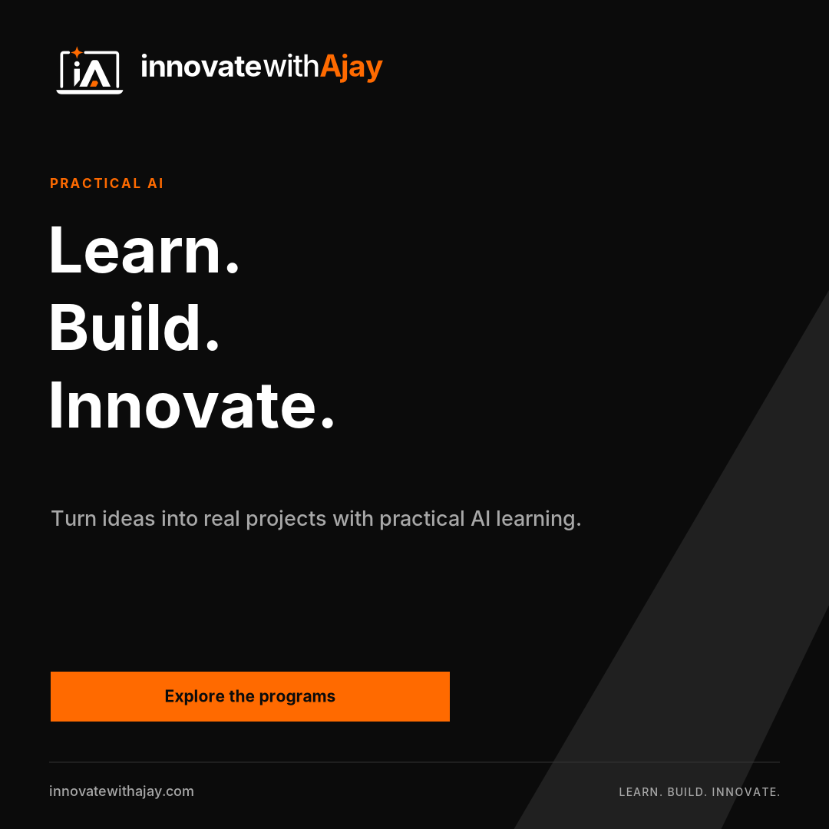
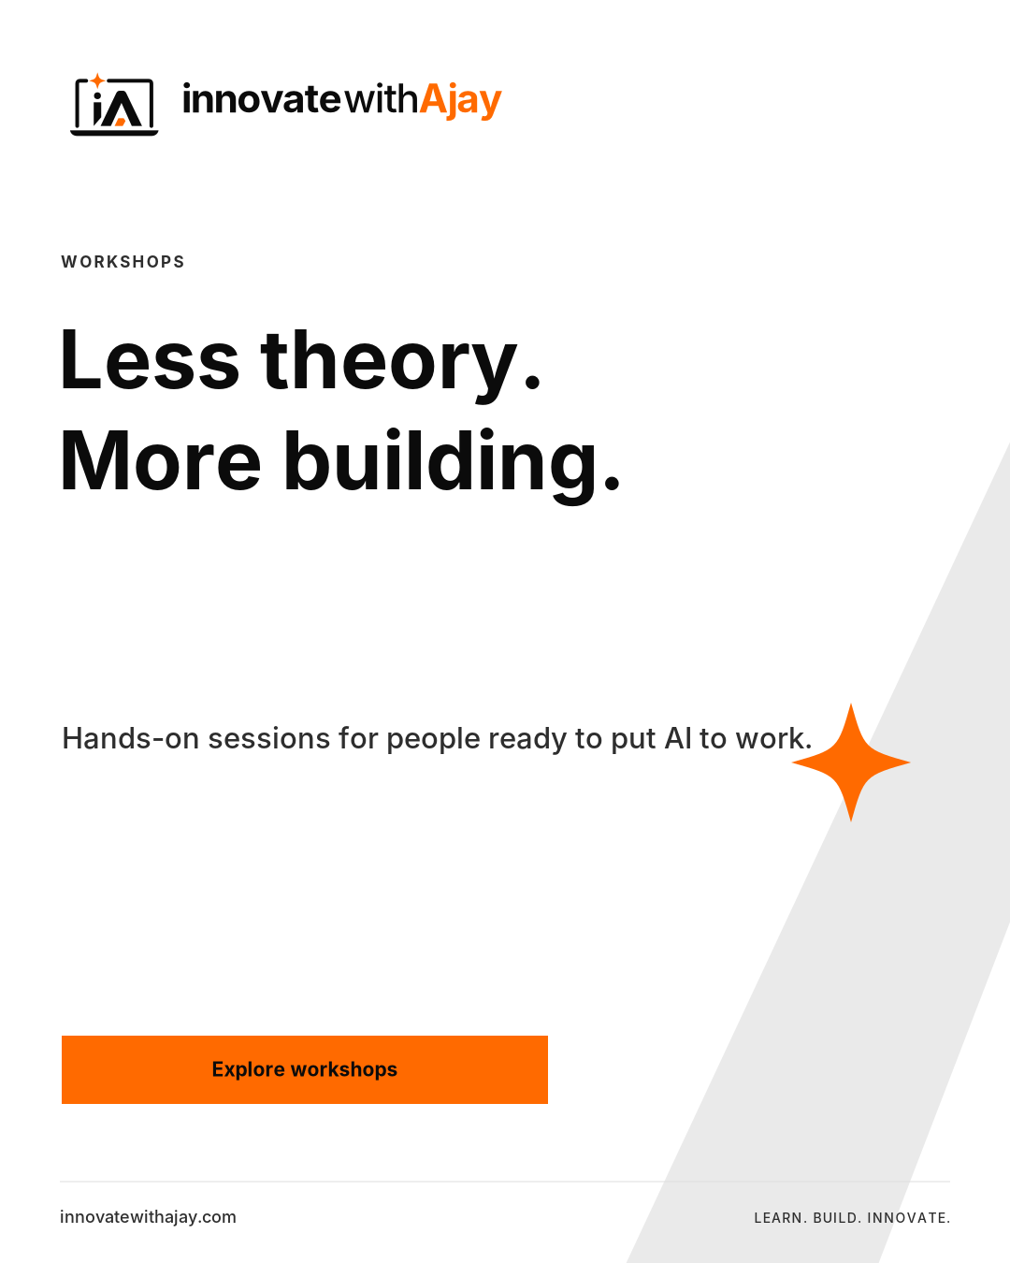
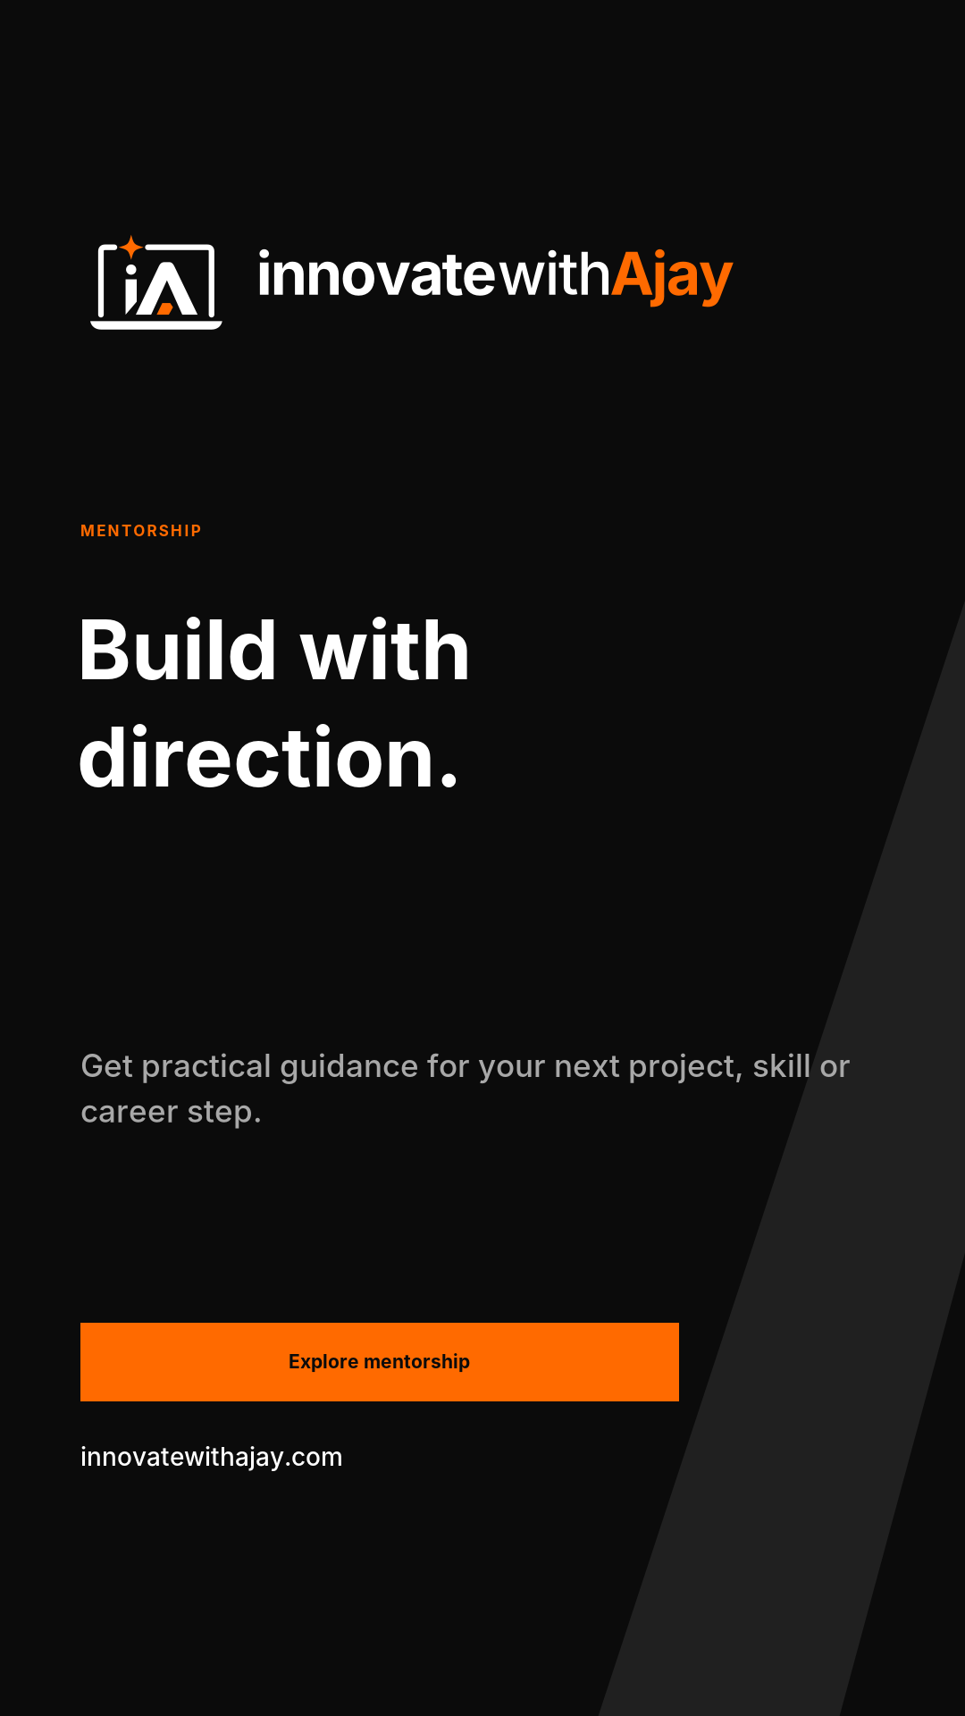
12 / SOCIAL CONTENT
One message. One useful next step.
A consistent hierarchy for posts, stories and announcements.
Replace all [placeholder] copy. Keep important text away from app controls. Never publish invented testimonials or outcomes.
INNOVATEWITHAJAY / CLEAN LAPTOP EDITION / v2.0
13

Slide 14
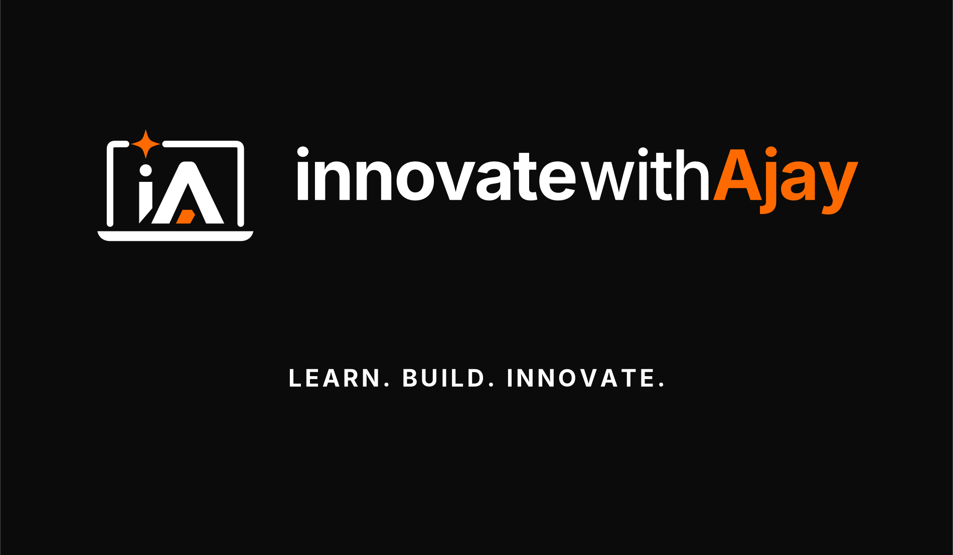
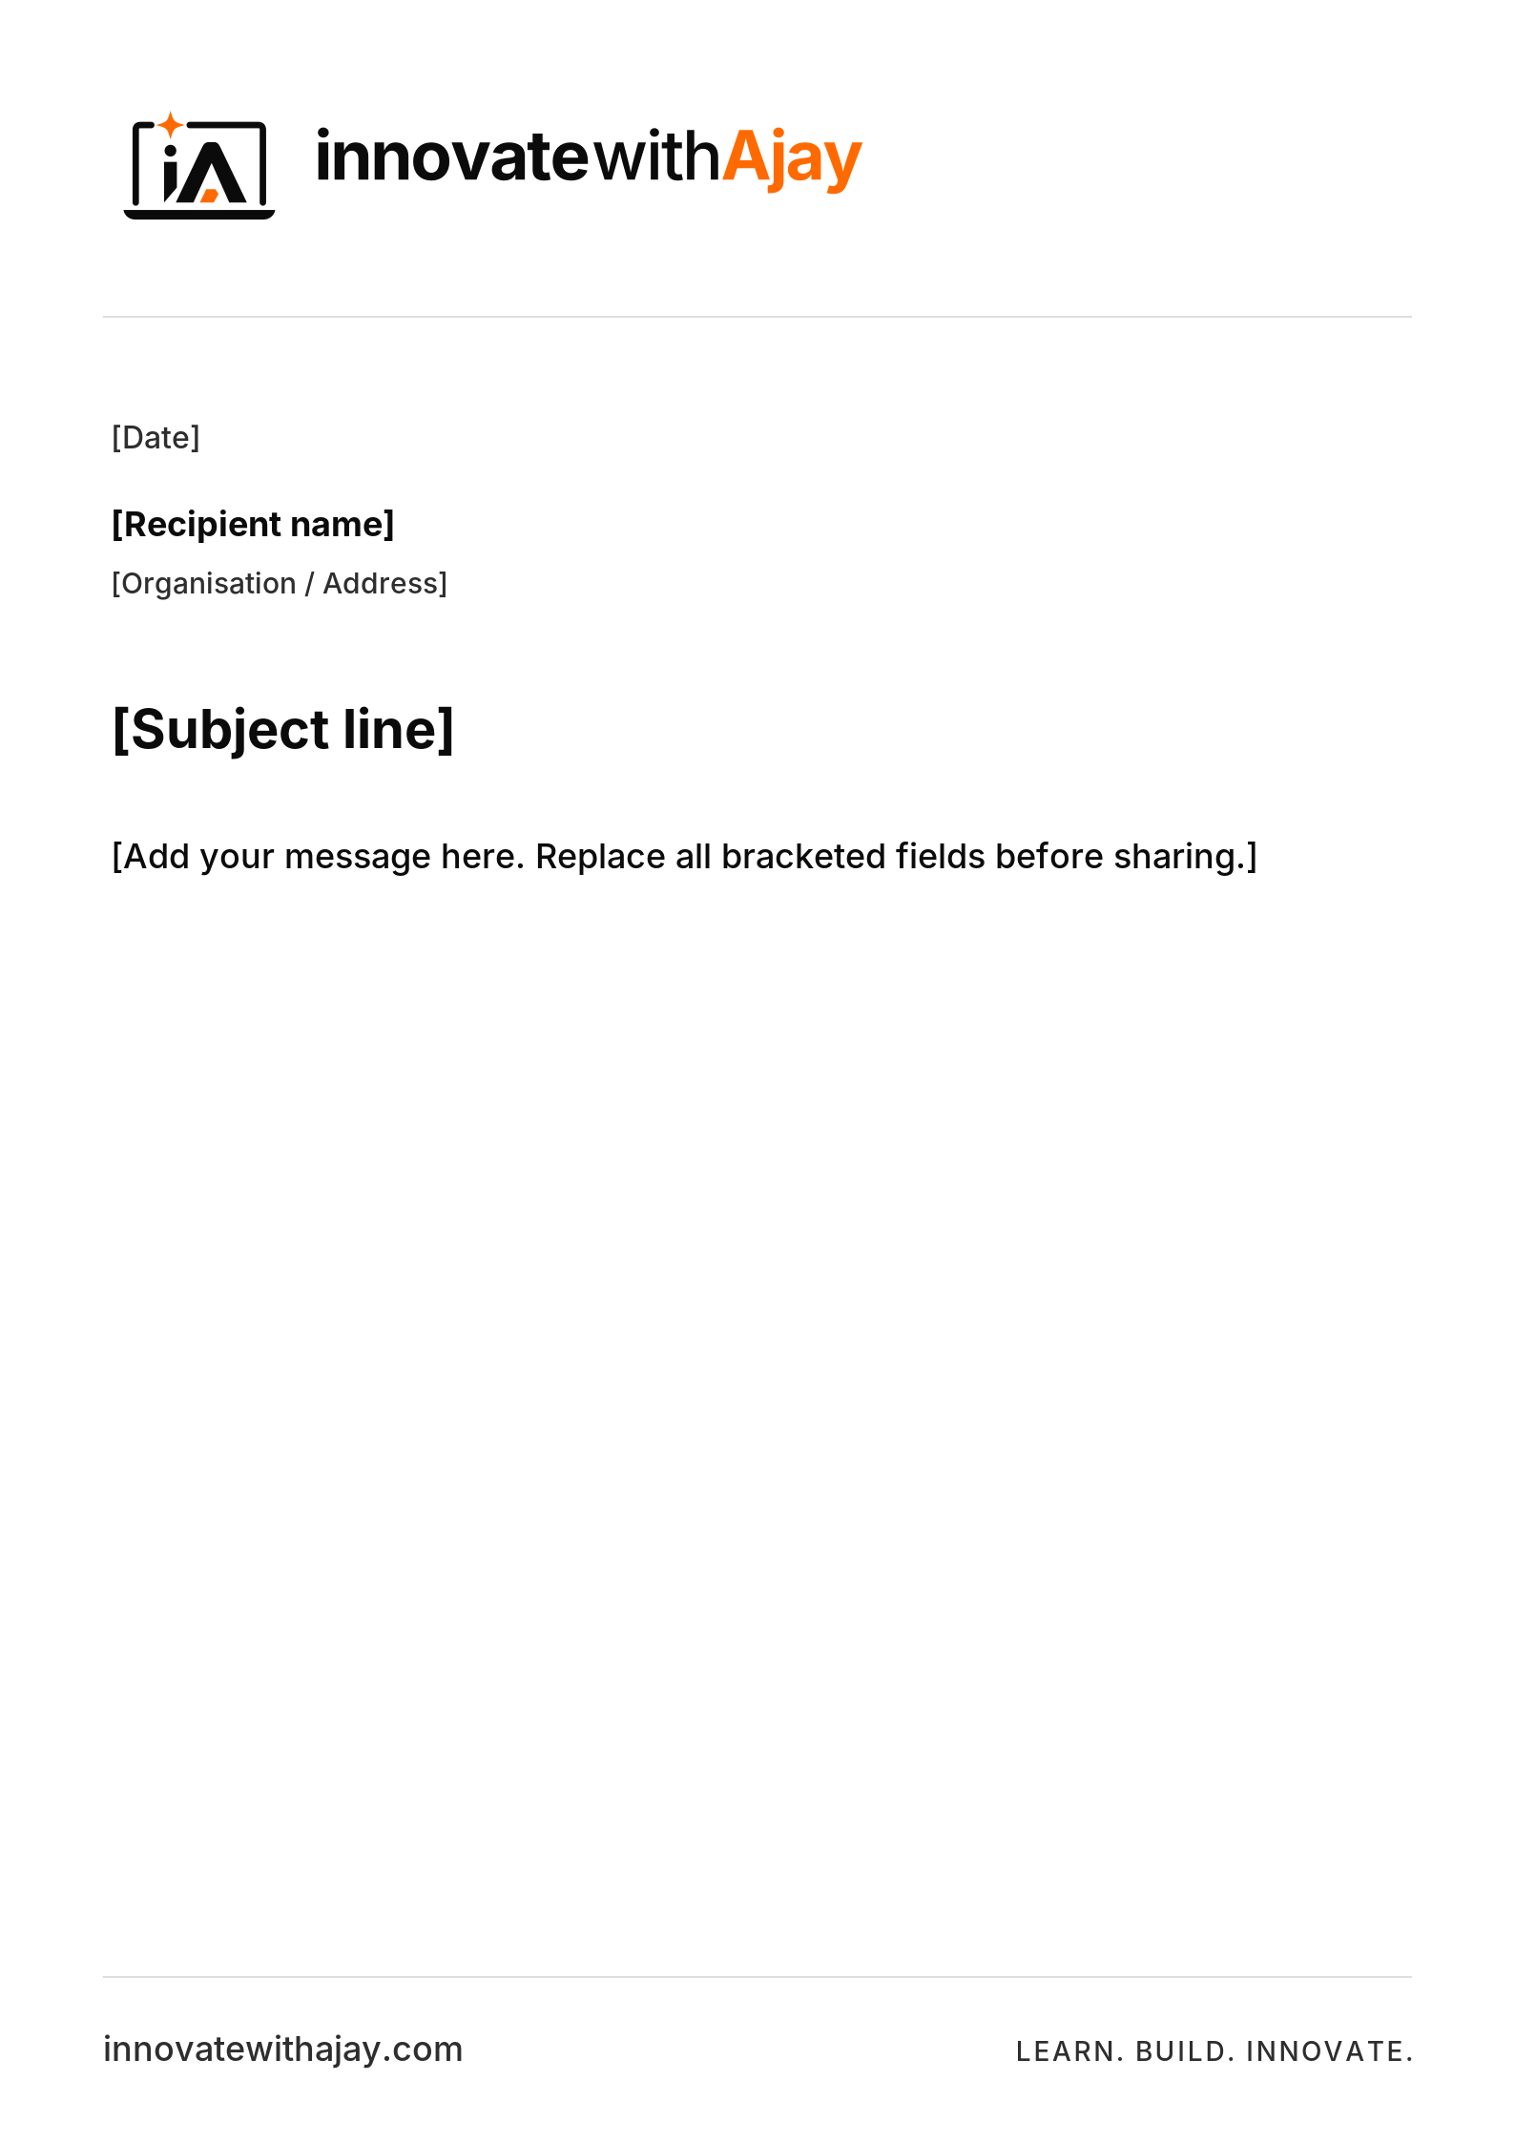
13 / STATIONERY
Professional at every touchpoint.
Use the same logo, typography and contact details across stationery.
Business card front/back, A4 letterhead, envelope, invoice layout, ID card and thank-you card are included.
INNOVATEWITHAJAY / CLEAN LAPTOP EDITION / v2.0
14

Slide 15
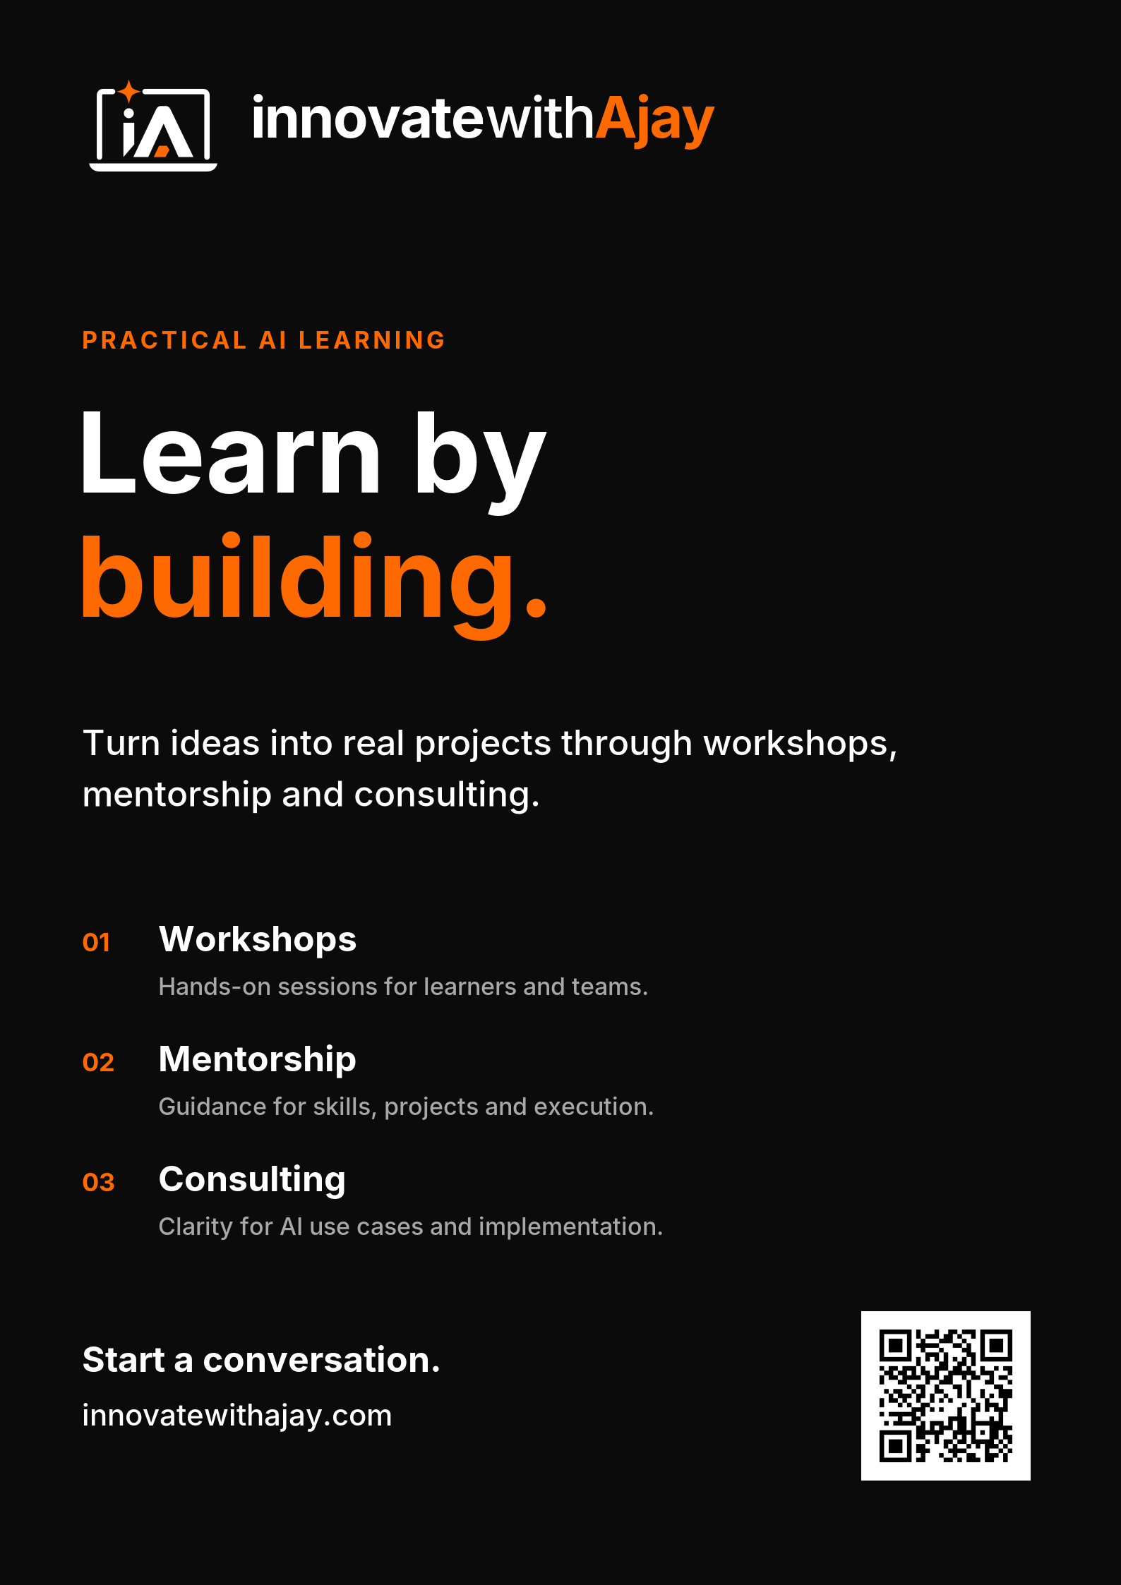

14 / MARKETING
Marketing without unsupported claims.
Lead with a practical outcome and a specific, honest invitation.
Ready-to-adapt assets
Flyers and posters
Four-page brochure
Workshop announcements
Display ad sizes
Certificates
Presentation templates
Do not publish certificates as accreditation. Finalize the recipient, event, date, criteria and authorized signature first.
INNOVATEWITHAJAY / CLEAN LAPTOP EDITION / v2.0
15

Slide 16

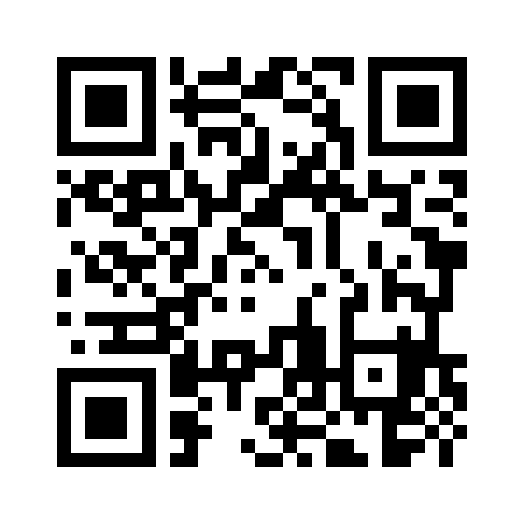
15 / DIGITAL
Web, app and email essentials.
Choose the correct file; keep the underlying brand system unchanged.
Website header: outlined SVG
Favicon: supplied ICO / SVG / PNG
Sharing: Open Graph card
Design system: CSS and JSON tokens
Email: HTML signature and newsletter
innovatewithajay.com
Scan-test after resizing or printing. Use a white quiet zone; do not recolor the QR into a low-contrast accent.
INNOVATEWITHAJAY / CLEAN LAPTOP EDITION / v2.0
16

Slide 17
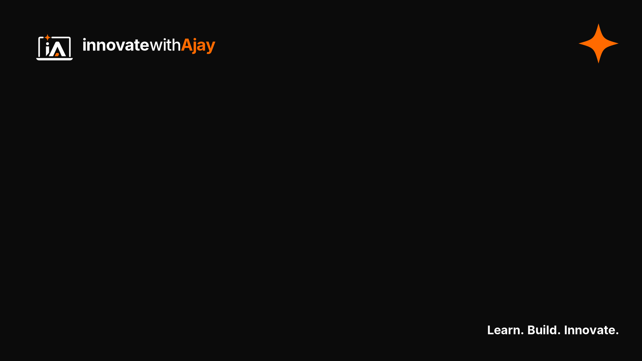


16 / VIDEO, MERCH & EVENTS
From a screen to a physical space.
Production artwork is supplied; each manufacturer still needs a final proof.
Merchandise, rollup, backdrop and signage are flat artwork—not embroidery, cut paths or vendor dielines. Confirm placement, dimensions and materials.
Video: lower third, watermark, virtual background and end screen.
INNOVATEWITHAJAY / CLEAN LAPTOP EDITION / v2.0
17

Slide 18
17 / BRAND VOICE
A voice people can trust.
Clear, practical, encouraging. Expertise without exaggeration.
Say what people will do
Make the next action clear
“Build a useful AI workflow.”
“Bring your project and define the next step.”
Explore programs.
Discuss your project.
Start a conversation.
Avoid guarantees and invented proof.
No “100% results”, fabricated learner counts, fake client logos, assumed accreditation or unapproved testimonials. Use verified, permission-based evidence.
INNOVATEWITHAJAY / CLEAN LAPTOP EDITION / v2.0
18

Slide 19
18 / PRODUCTION HANDOFF
A kit that is easy to hand off.
Start with START_HERE.html. Use the asset manifest to find the exact file.
SVG
Scalable logos, editable artwork and source masters.
PNG / ICO
Transparent logo exports, social posts and app icons.
PDF
Guidelines, brochures, print layouts and certificates.
PPTX / DOCX
Editable presentations, social slides and documents.
HTML / CSS / JSON
Email, web components and brand design tokens.
Print gate: verify trim, bleed, color profile and supplier dielines. PDFs are RGB layouts, not certified PDF/X files. Use vector files for large-format print.
INNOVATEWITHAJAY / CLEAN LAPTOP EDITION / v2.0
19

Slide 20
19 / REFERENCES
Sources, scope and release notes.
This package supersedes the earlier arrow-only and pixel-heavy versions.
S1 / YouTube
support.google.com/youtube/answer/10456525
S2 / LinkedIn profile
linkedin.com/help/linkedin/answer/a568217
S3 / LinkedIn Page
linkedin.com/help/linkedin/answer/a563309
S4 / X header
help.x.com/en/managing-your-account/how-to-customize-your-profile
S5 / Contrast
w3.org/WAI/WCAG22/Understanding/contrast-minimum.html
S6 / Inter
rsms.me/inter/
Reference pages checked 29 October 2026. Other canvas sizes are editable production presets; always inspect the final platform upload.
The artwork is a consistent vector reconstruction of the approved visual direction. Fonts are not bundled. Native AI, PSD, FIG and Canva project files are not included. Trademark clearance and exclusivity have not been independently established.
INNOVATEWITHAJAY / CLEAN LAPTOP EDITION / v2.0
20

